Slide 1
Class Diagram

Slide 2
UML Diagrams
Note – In this course we are focusing only on class diagram, the foucs in this subject is to lean
object oriented concepts

Slide 3
Class diagram
A class diagram depicts classes and their interrelationships
Provide a conceptual model of the system in terms of entities and their relationships
Used for requirement capture, end-user interaction
Detailed class diagrams are used for developers

Slide 4
Class diagram
Name
Account_Name
- Customer_Name
- Balance
Attributes
+addFunds( )
+withDraw( )
+transfer( )
Operations
The access specifiers are:
•public –denoted by +
•private –denoted by –
•protected –denoted by #
•default or package –denoted by ~

Slide 5
OO Relationships
There are two kinds of Relationships
Generalization (parent-child relationship)
Association (student enrolls in course)
Associations can be further classified as
Aggregation
Composition

Slide 6
Class diagram
Each class is represented by a rectangle subdivided into three compartments
Name
Attributes
Operations
Modifiers are used to indicate visibility of attributes and operations.
‘+’ is used to denote Public visibility (everyone)
‘#’ is used to denote Protected visibility (friends and derived)
‘-’ is used to denote Private visibility (no one)
‘~’ is used to denote default visibility (package)
By default, attributes are hidden and operations are visible.

Slide 7
OO Relationships: Generalization
Supertype
Example:
Customer
Regular
Customer
Loyalty
Customer
Subtype1
Subtype2
-Inheritance is a required feature of object orientation
-Generalization expresses a parent/child relationship among related classes.
Used for abstracting details in several layers
It represents “is-A” relationship. Regular customer “is-A” customer.

Slide 8
OO Relationships: Association
Represent relationship between instances of classes
Student enrolls in a course
Courses have students
Courses have exams
Etc.
Association has two ends
Role names (e.g. enrolls)
Multiplicity (e.g. One course can have many students)
Navigability (unidirectional, bidirectional)

Slide 9
Association: Multiplicity and Roles
student
1
*
University
Person
0..1
*
employer
teacher
Multiplicity
Symbol Meaning
1 One and only one
0..1 Zero or one
M..N From M to N (natural language)
* From zero to any positive integer
0..* From zero to any positive integer
1..* From one to any positive integer
Role
Role
“A given university groups many people; some act as students, others as teachers. A given student belongs to a single university; a given teacher may or may not be working for the university at a particular time.”

Slide 10
Association: Model to Implementation
*
4
Student
Course
has
enrolls
Class Student {
Course enrolls[4];
}
Class Course {
Student have[];
}

Slide 11
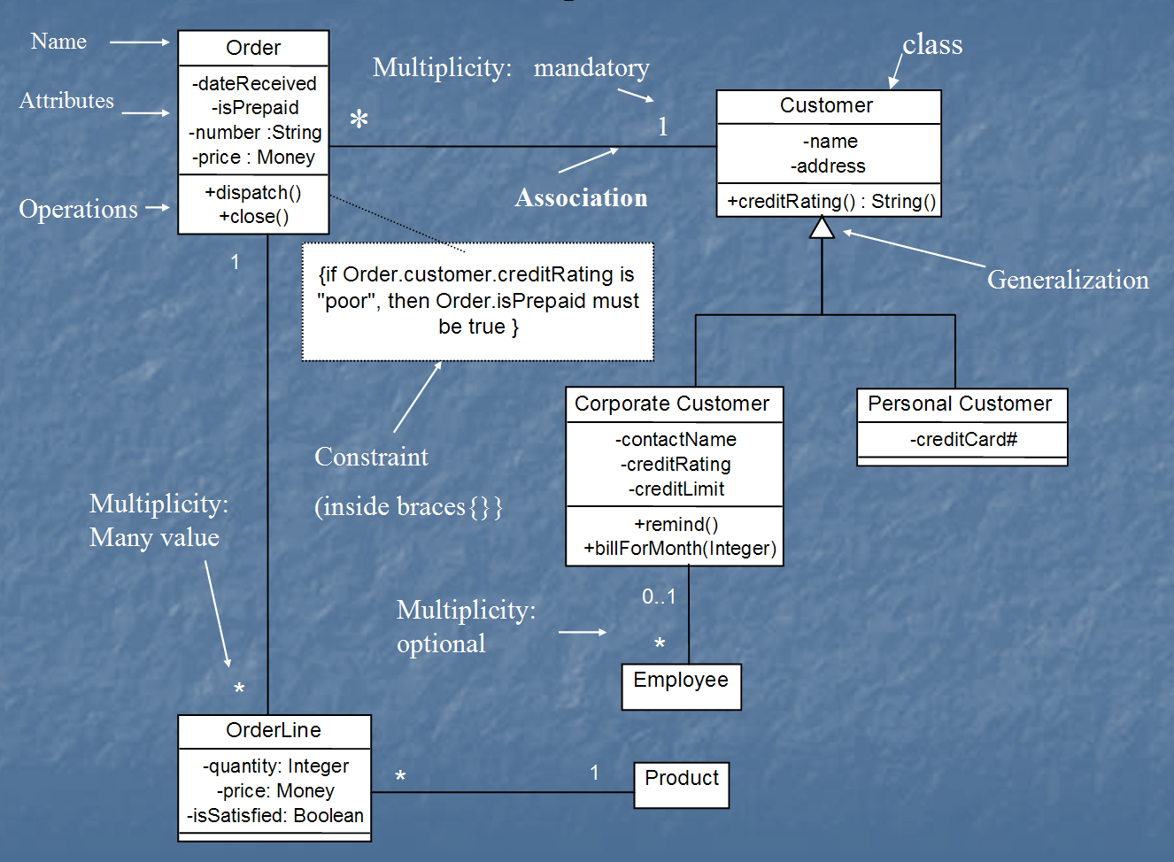
Class Diagram
[from UML Distilled Third Edition]

Slide 12
OO Relationships: Aggregation
Container Class
Aggregation:
expresses a relationship among instances of related classes. It is a specific kind of Container-Containee relationship.
express a more informal relationship than composition expresses.
Aggregation is appropriate when Container and Containees have no special access privileges to each other.
It represents “Has-A” relationship
Bag has Apples , Milk.
Class C
AGGREGATION
Class E₁
Class E₂
Containee Classes
Example
Bag
Apples
Milk
[From Dr.David A. Workman]

Slide 13
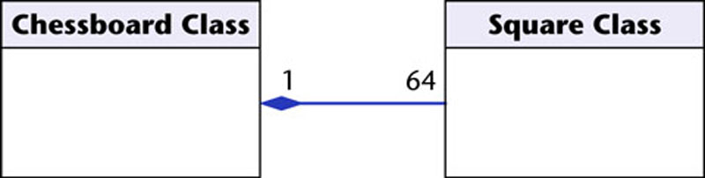
OO Relationships: Composition
Class W
Association
Models the part–whole relationship. “part-of” relationship
Composition
Also models the part–whole relationship but, in addition, Every part may belong to only one whole, and If the whole is deleted, so are the parts
Example:
A number of different chess boards: Each square belongs to only one board. If a chess board is thrown away, all 64 squares on that board go as well.
Whole Class
Class P₁
Class P₂
Part Classes
[From Dr.David A. Workman]
Example
Figure 16.7
The McGraw-Hill Companies, 2005

Slide 14
Aggregation vs. Composition
Composition is really a strong form of association
components have only one owner
components cannot exist independent of their owner
components live or die with their owner
e.g. Each car has an engine that can not be shared with other cars.
Aggregations
may form "part of" the association, but may not be essential to it. They may also exist independent of the aggregate. e.g. Apples may exist independent of the bag.

Slide 15
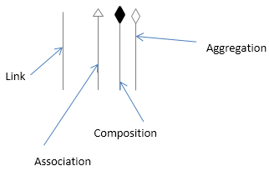
Links notation
Link: We use a link to symbolize a relationship between two objects.
Association: Association is a reference relationship among two objects (or classes).”is-A” relationship
Composition: Composition can be described as a form of relationship where
children are not able to occur independently of the difference. “part-whole” relationship.
Aggregation: Aggregation signifies a “has a” relationship.

Slide 16
Exercise
Class diagram for Library management system
Identify relevant classes
Identify attributes and methods for each class
Identify the relationships between them , their associations etc.
Draw the class diagram
Review the diagram and keep refining.

